Slide 1
Lab. 04
Logic Design Lab.
Spring 2014
Prof. Naehyuck Chang
(naehyuck@snu.ac.kr)
TA. Taeyoung Kim
(tykim@iris.snu.ac.kr)
TA. Duseok Kang
(kangds0829@iris.snu.ac.kr)
RUBIS

Slide 2
Contents
Universal Board
Practice
Preliminary Report
RUBIS

Slide 3
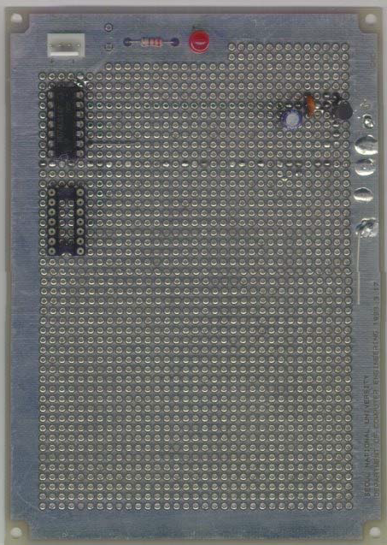
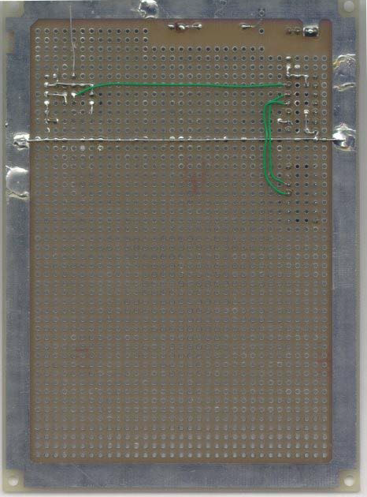
Universal Board
Component side - GND
Solder side - VCC
RUBIS

Slide 4
Power Bus
Why?
  Area of a loop ∝ EMI (Electro-Magnetic Interference)
  We should minimize the length of path.
RUBIS

Slide 5
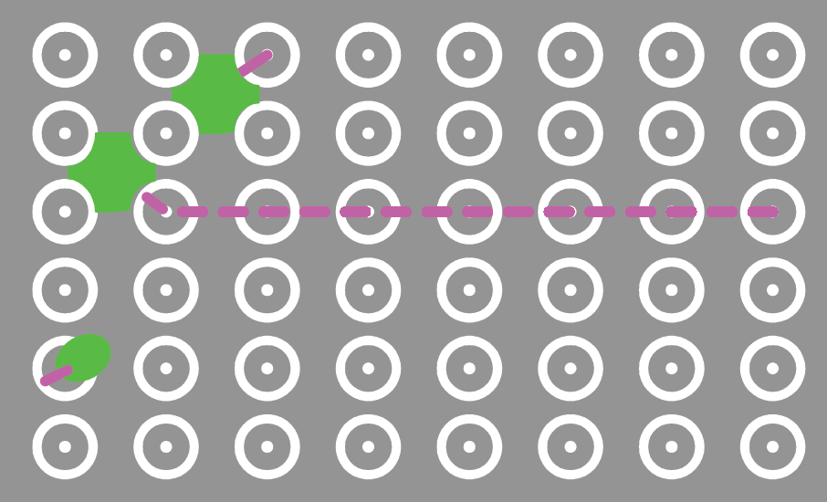
Double sided solid GND plane
GND plane
RUBIS

Slide 6
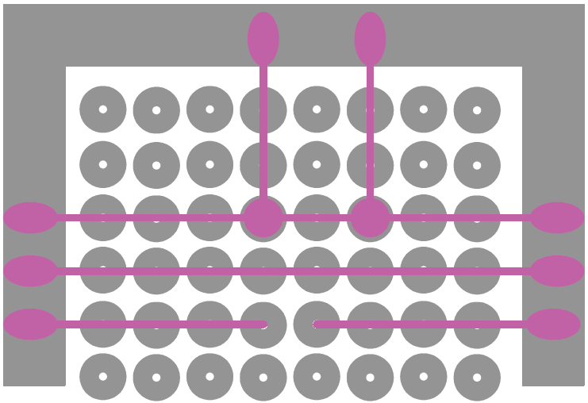
Make VCC mesh (grid)
VCC plane
RUBIS

Slide 7
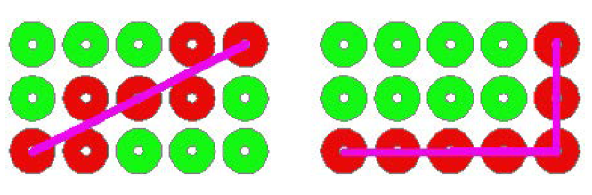
Make VCC mesh (grid)
RUBIS

Slide 8
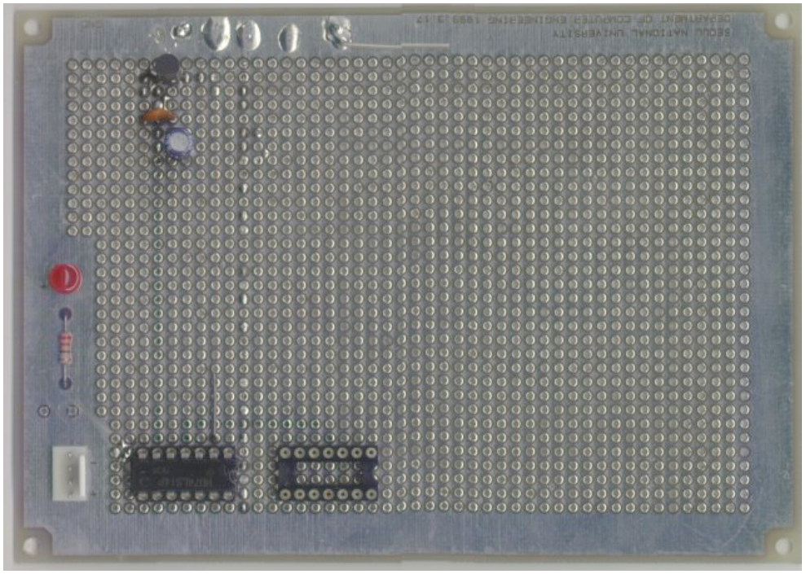
Preparation for Prototyping
LED
Register
Power Connector
RUBIS

Slide 9
Practice (result report)
Implement a circuit on an universal board.
  Implement the circuit that you have drawn in Preliminary Report, Practice03, 3).
  Use one NOT gate, two AND gates and one OR gate.
  Check the output using a LED.
Write result report about today’s practice. Maximum 3 pages.
Due : March, 24th
RUBIS

Slide 10

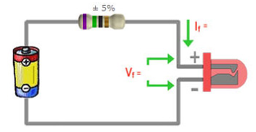
Practice (Cont.)
Output : LED
  Voltage = 1.8~2.0V, Current = 0.01A
  So, we should use about 300Ω resister.
RUBIS

Slide 11
Preliminary Report
Requirements
  Either in Korean or in English
  Maximum 3 pages
  Due : March, 19th
Explain ‘critical path delay’.
  What it is / How can we measure it
Implement an inverter using 2-input NOR gate or 2-input NAND gate. (draw a circuit diagram)
Implement an AND gate using 2 NAND gates or 3 NOR gates. (draw a circuit diagram)
RUBIS

Slide 12
Preliminary Report (Cont.)
Draw a circuit diagram for the below formula using ONLY NOR gates and NOT gates.
  Y = A(B+CD)
Y = AB + ABC + A’B + AB’C
  Make a truth table
  Minimize
  Draw a circuit diagram
RUBIS

Slide 13
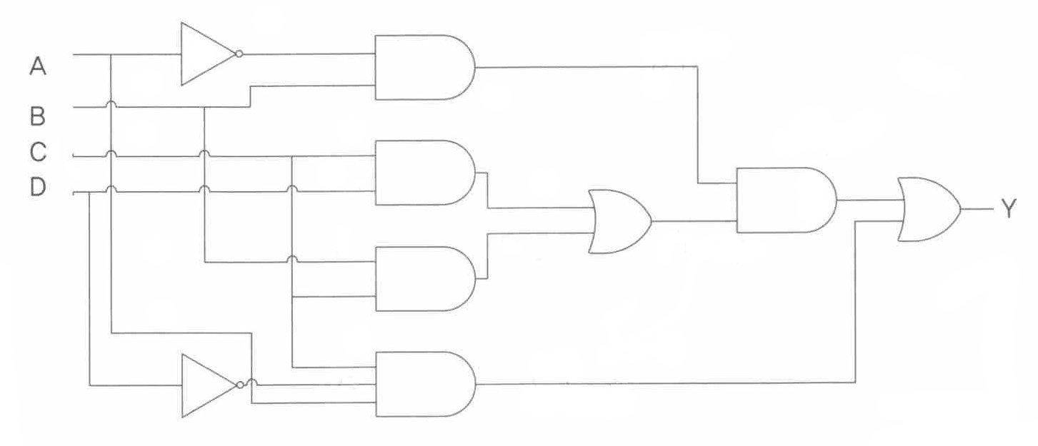
Preliminary Report (Cont.)
For the given circuit,
  Minimize it using ONLY inverters, 3-input AND gates, 2-input OR gates
  Minimize it using ONLY inverters, 2-input AND gates, 2-input OR gates
RUBIS

